Slide 1
Analyzing algorithms
Fariha Tabassum islam

Slide 2
Asymptotic Notation
Analyzing Runtime

Slide 3
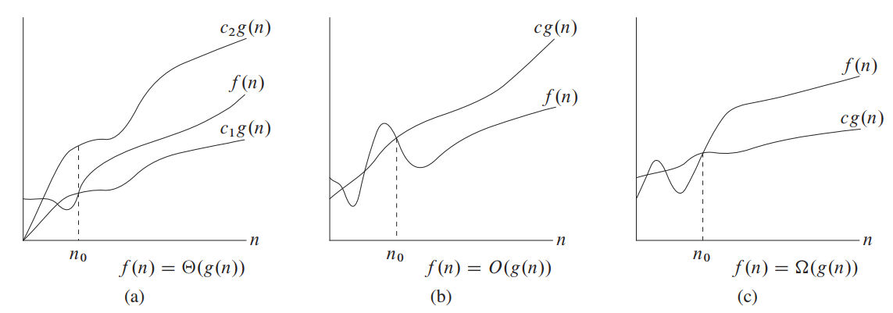
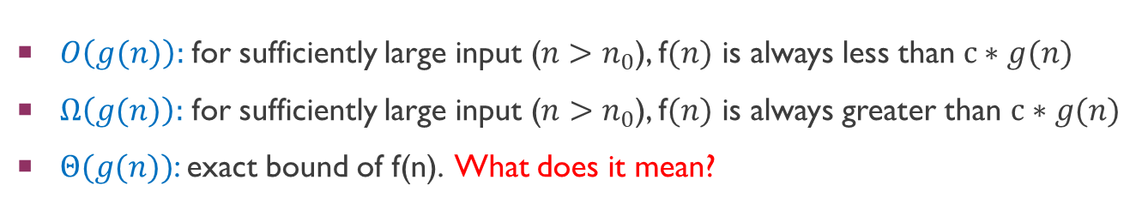
Asymptotic notations
$O\left(g(n)\right):$ for sufficiently large input ($n>n_{0}$), f$(n)$ is always less than $c∗g(n)$
$Ω\left(g(n)\right):$ for sufficiently large input ($n>n_{0}$), f$(n)$ is always greater than $c∗g(n)$
$Θ(g(n))$: exact bound of f(n). What does it mean?

Slide 4

Asymptotic notations
Assume: $T\left(n\right)=5n^{3}+4n+1$, $g\left(n\right)=n^{3}$
$T\left(n\right)$ is $O\left(n^{3}\right)$
$T(n)$ is $Ω\left(n^{3}\right)$
$T(n)$ is $Θ\left(n^{3}\right)$
$T\left(n\right)$ is $O\left(n^{7}\right)$
$T(n)$ is $Θ\left(n^{2}\right)$

Slide 5
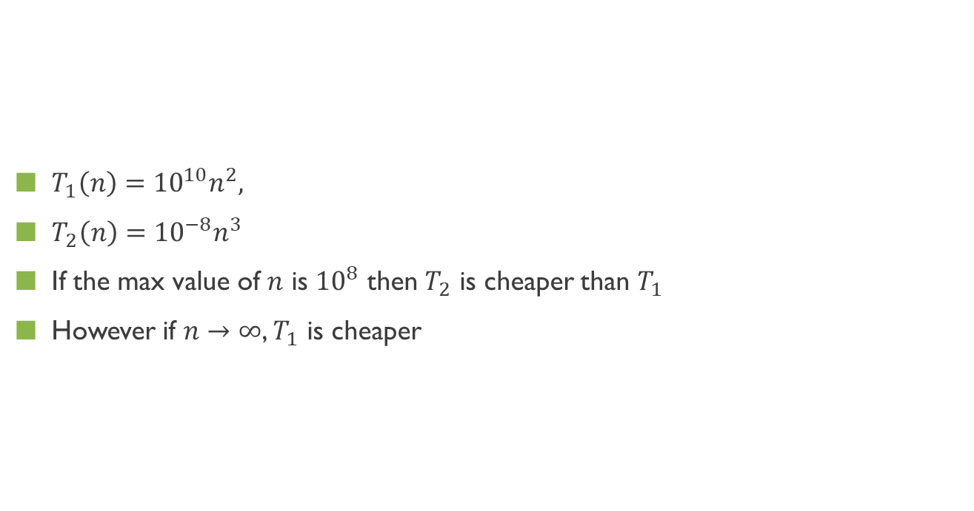
Asymptotic analysis
$T_{1}\left(n\right)={10}^{10}n^{2},$
$T_{2}\left(n\right)={10}^{−8}n^{3}$
If the max value of $n$ is ${10}^{8}$ then $T_{2}$ is cheaper than $T_{1}$
However if $n→∞$, $T_{1}$ is cheaper

Slide 6
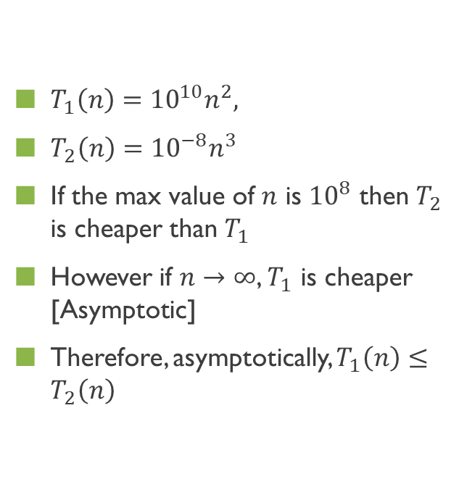
Asymptotic analysis
$T_{1}\left(n\right)={10}^{10}n^{2},$
$T_{2}\left(n\right)={10}^{−8}n^{3}$
If the max value of $n$ is ${10}^{8}$ then $T_{2}$ is cheaper than $T_{1}$
However if $n→∞$, $T_{1}$ is cheaper [Asymptotic]
Therefore, asymptotically, $T_{1}\left(n\right)≤T_{2}\left(n\right)$
The term asymptotic means approaching a value (e.g. infinity) or curve arbitrarily closely (i.e., as some sort of limit is taken).

Slide 7
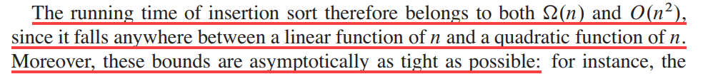
Asymptotic analysis

Slide 8
Exact cost analysis
best and worst case analysis

Slide 9
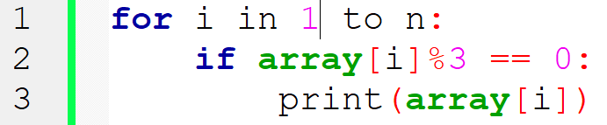
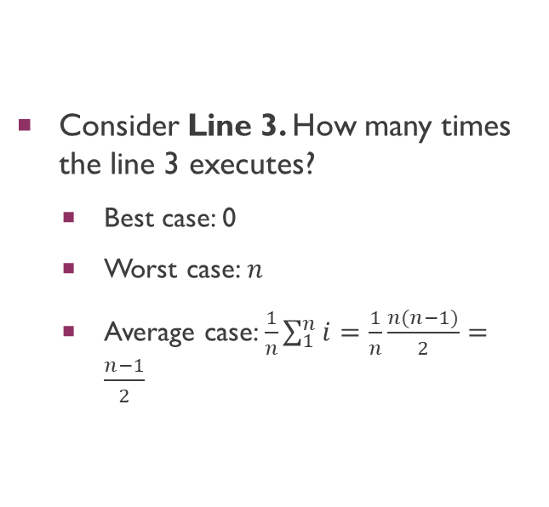
EXACT COST ANALYSIS: Example 1
Consider Line 3. How many times the line 3 executes?
Best case: 0
Worst case: $n$
Average case: $\frac{1}{n}\sum_{1}^{n}{i}=\frac{1}{n}\frac{n(n−1)}{2}=\frac{n−1}{2}$

Slide 10

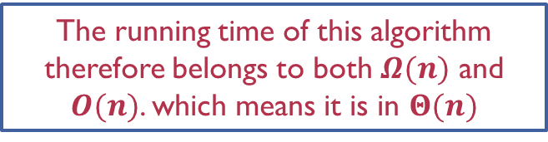
EXACT COST ANALYSIS: Example 1
The running time of this algorithm therefore belongs to both $Ω(n)$ and $O(n)$. which means it is in $Θ(n)$
Line 1: $n+1$
Line 2: $n$
Line 3
Best case: 0
Worst case: $n$
Average case: $\frac{1}{n}\sum_{1}^{n}{i}=\frac{1}{n}\frac{n(n−1)}{2}=\frac{n−1}{2}$

Slide 11
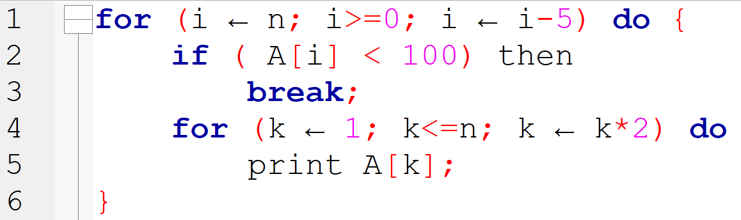
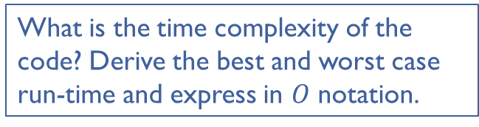
EXACT COST ANALYSIS: Example 2
Line | Worst | Best
1
2
3
4
5
Asymptotic
What is the time complexity of the code? Derive the best and worst case run-time and express in $O$ notation.

Slide 12
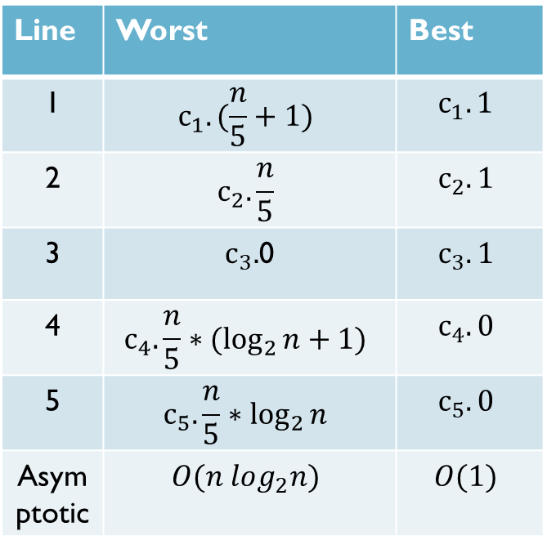
EXACT COST ANALYSIS: Example 2
Line | Worst | Best
1 | $$c_{1}.(\frac{n}{5}+1)$$ | $$c_{1}.1$$
2 | $$c_{2}.\frac{n}{5}$$ | $$c_{2}.1$$
3 | $c_{3}.$0 | $$c_{3}.1$$
4 | $$c_{4}.\frac{n}{5}∗(\log_{2}{n}+1)$$ | $$c_{4}.0$$
5 | $$c_{5}.\frac{n}{5}∗\log_{2}{n}$$ | $$c_{5}.0$$
Asymptotic | $$O(n log_{2}n)$$ | $$O(1)$$

Slide 13

EXACT COST ANALYSIS: Example 2
Observe Line 1
value of $i$: $n, n−5, n−10$, … until less than 0
therefore, runs $\frac{n}{5}+1$ times

Slide 14
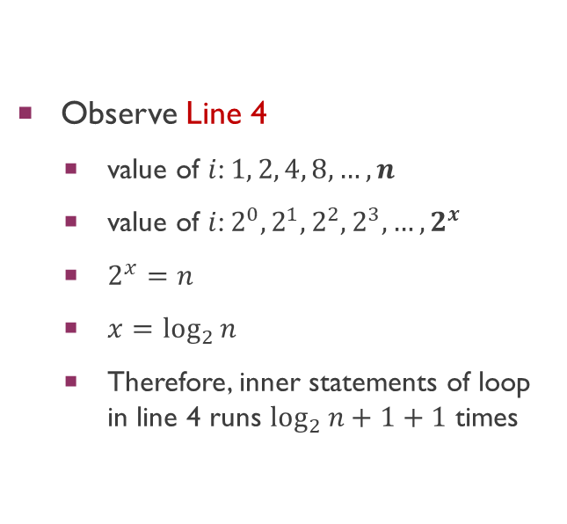
EXACT COST ANALYSIS: Example 2
Observe Line 4
value of $i$: $1, 2, 4, 8, …,n$
value of $i$: $2^{0}, 2^{1}, 2^{2},2^{3}, …,2^{x}$
$2^{x}=n$
$x=\log_{2}{n}$
Therefore, inner statements of loop in line 4 runs $\log_{2}{n}+1+1$ times

Slide 15

EXACT COST ANALYSIS: Example 2
Best case: $Ω(1)$
Worst case: $O\left(n\log_{2}{n}\right)$ or $O\left(nlgn\right)$
The running time of this algorithm therefore belongs to both $Ω(1)$ and $O(nlgn)$

Slide 16

for (i=1; i<=n;i++)
for (i=n;i>=1;i--)
$k←1;k≤n;k←k∗2$
$k←n;k≥1;k←k/2$

Slide 17
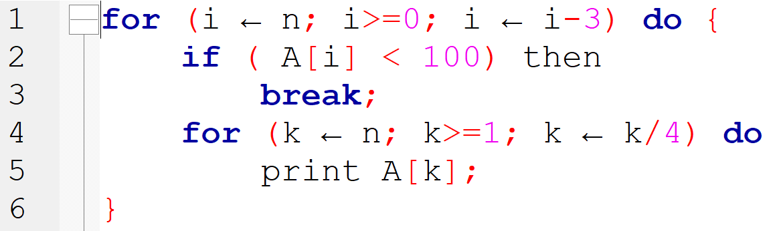

EXACT COST ANALYSIS: example 3
Line | Worst | Best
1
2
3
4
5
Asymptotic
$$\log_{4}{n}=\log_{2^{2}}{n}=\frac{1}{2}∗\log_{2}{n}$$
Derive the running-time equations and express in "O" notation

Slide 18
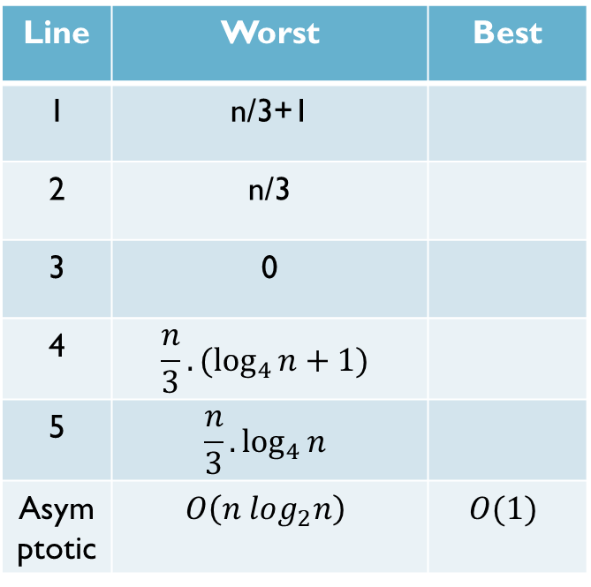
EXACT COST ANALYSIS: example 3
Line | Worst | Best
1 | n/3+1
2 | n/3
3 | 0
4 | $$\frac{n}{3}.{(log}_{4}{n}+1)$$
5 | $$\frac{n}{3}.\log_{4}{n}$$
Asymptotic | $$O\left(n log_{2}n\right)$$ | $$O(1)$$
$$\log_{4}{n}=\log_{2^{2}}{n}=\frac{1}{2}∗\log_{2}{n}$$

Slide 19
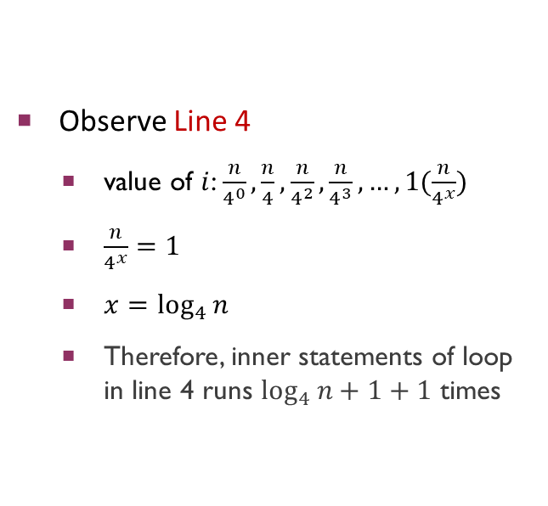
EXACT COST ANALYSIS: example 3
Observe Line 4
value of $i$: $\frac{n}{4^{0}},\frac{n}{4},\frac{n}{4^{2}},\frac{n}{4^{3}},…,1(\frac{n}{4^{x}})$
$\frac{n}{4^{x}}=1$
$x=\log_{4}{n}$
Therefore, inner statements of loop in line 4 runs $\log_{4}{n}+1+1$ times

Slide 20

EXACT COST ANALYSIS: example 3
Best case: $Ω(1)$
Worst case: $O\left(n\log_{2}{n}\right)$ or $O\left(nlgn\right)$
The running time of this algorithm therefore belongs to both $Ω(1)$ and $O(nlgn)$

Slide 21
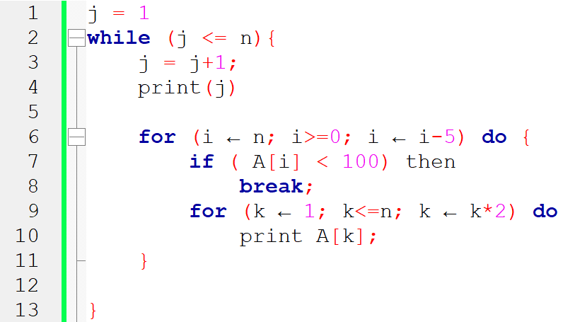
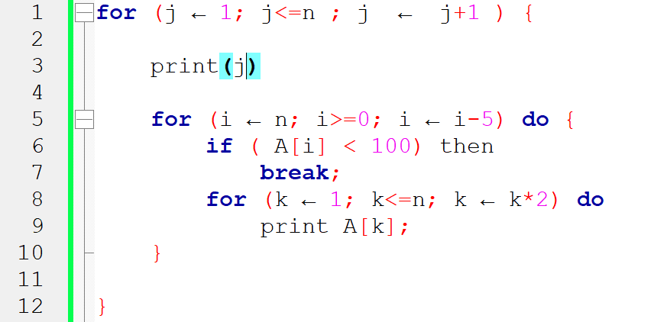
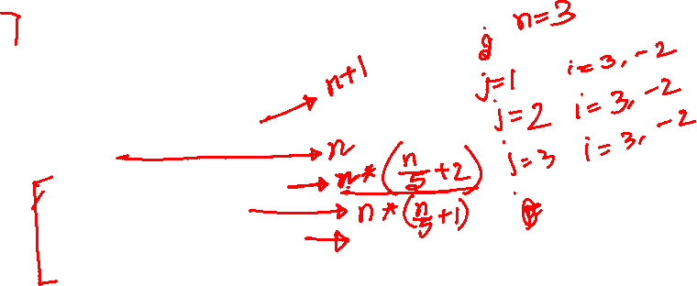

Slide 23
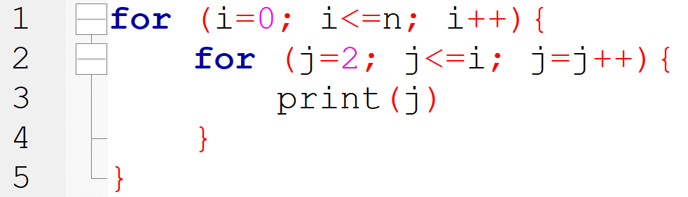
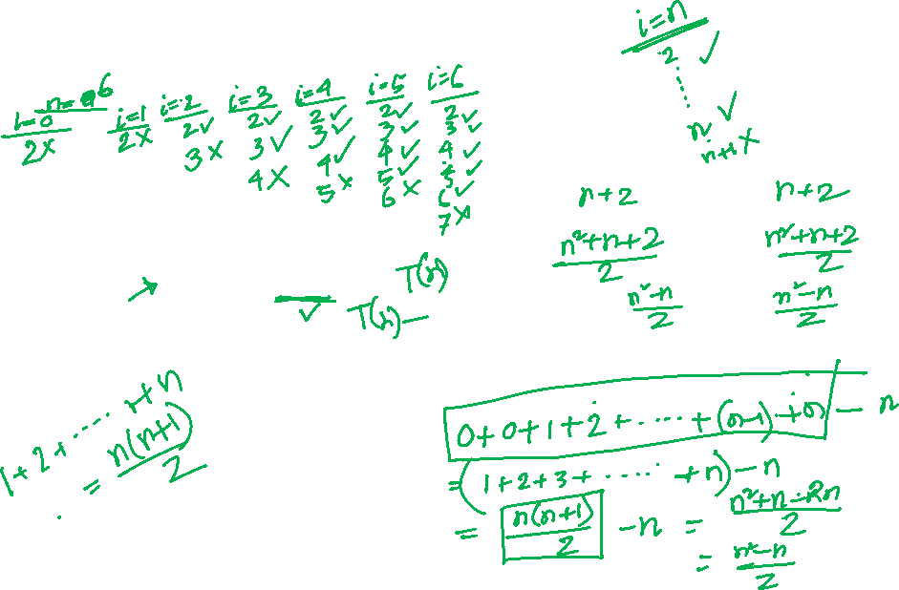
EXACT COST ANALYSIS: example 4
Line | Worst | Best
1
2
3
Asymptotic
Derive the running-time equations and express in "O" notation

Slide 24
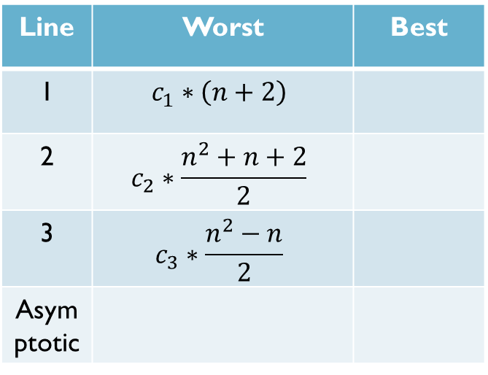
EXACT COST ANALYSIS: example 4
Line | Worst | Best
1 | $$c_{1}∗\left(n+2\right)$$
2 | $$c_{2}∗\frac{n^{2}+n+2}{2}$$
3 | $$c_{3}∗\frac{n^{2}−n}{2}$$
Asymptotic
Derive the running-time equations and express in "O" notation

Slide 25

How many times line 1 run?
if n=2 then
0, 1, 2, 3 (when $i=3$, it fails to execute statements inside the loop)
$n+1+1$

Slide 26
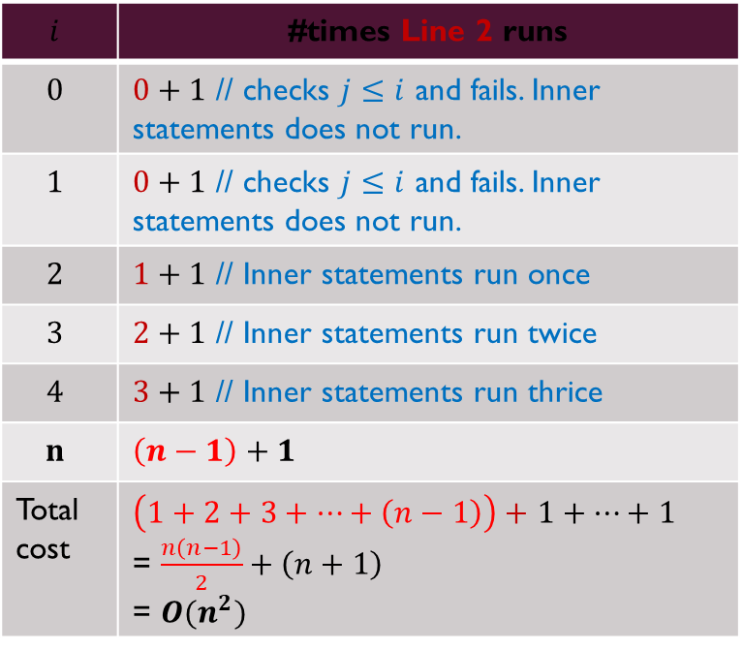
$$i$$ | #times Line 2 runs
$$0$$ | $0+1$ // checks $j≤i$ and fails. Inner statements does not run.
$$1$$ | $0+1$ // checks $j≤i$ and fails. Inner statements does not run.
$$2$$ | $1+1$ // Inner statements run once
$$3$$ | $2+1$ // Inner statements run twice
$$4$$ | $3+1$ // Inner statements run thrice
$$n$$ | $$\left(n−1\right)+1$$
Total cost | $\left(1+2+3+…+\left(n−1\right)\right)+$ $1+…+1$ = $\frac{n\left(n−1\right)}{2}+\left(n+1\right)$ = $O(n^{2})$

Slide 27
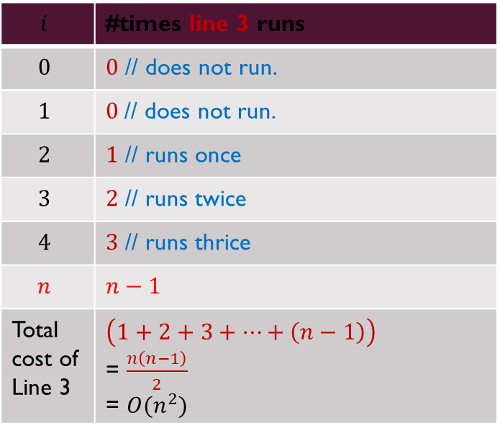
$$i$$ | #times line 3 runs
$$0$$ | $0$ // does not run.
$$1$$ | $0$// does not run.
$$2$$ | $1$ // runs once
$$3$$ | $2$ // runs twice
$$4$$ | $3$ // runs thrice
$$n$$ | $$n−1$$
Total cost of Line 3 | $\left(1+2+3+…+\left(n−1\right)\right)$ = $\frac{n\left(n−1\right)}{2}$ = $O(n^{2})$

Slide 28
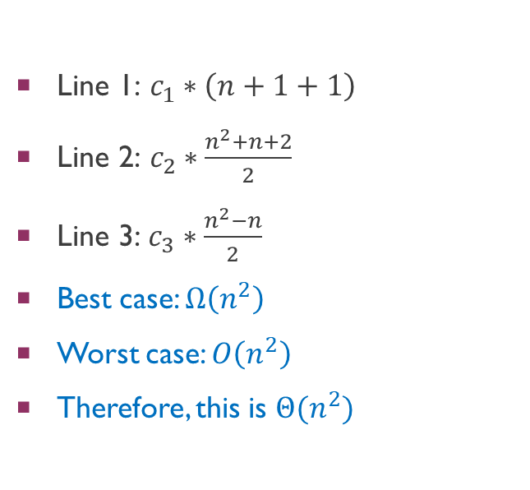
$\text{Line}\text{ 1: }c_{1}∗\left(n+1+1\right)$
$\text{Line}\text{ 2: }c_{2}∗\frac{n^{2}+n+2}{2}$
$\text{Line}\text{ 3:}$ $c_{3}∗\frac{n^{2}−n}{2}$
Best case: $Ω\left(n^{2}\right)$
Worst case: $O\left(n^{2}\right)$
Therefore, this is $Θ(n^{2})$
The running time of this algorithm therefore belongs to both $Ω(n^{2})$ and $O(n^{2})$, which means it is in $Θ(n^{2})$

Slide 29
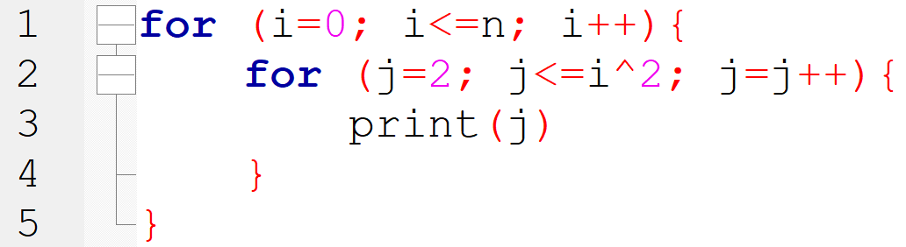
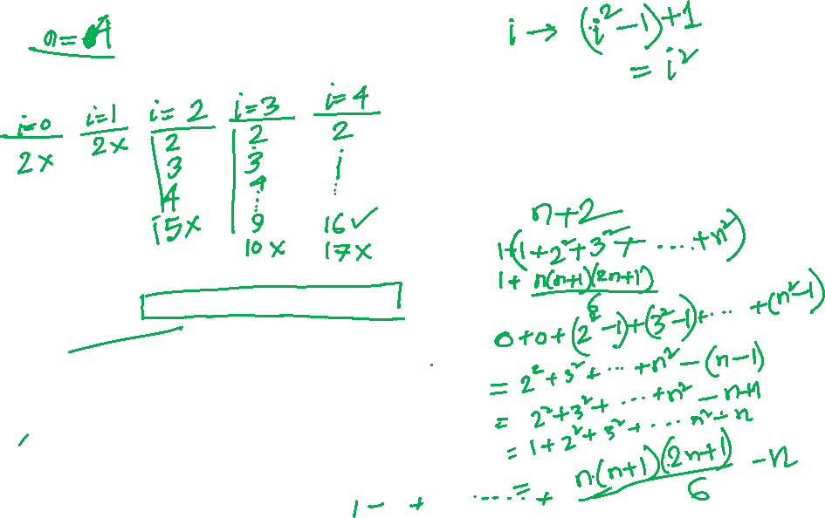
EXACT COST ANALYSIS: example 5
Line | Worst | Best
1
2
3
4
5
Asymptotic
Derive the running-time equations and express in "O" notation

Slide 30
EXACT COST ANALYSIS: example 5
Line | Worst | Best
1
2
3
4
5
Asymptotic
Derive the running-time equations and express in "O" notation

Slide 31
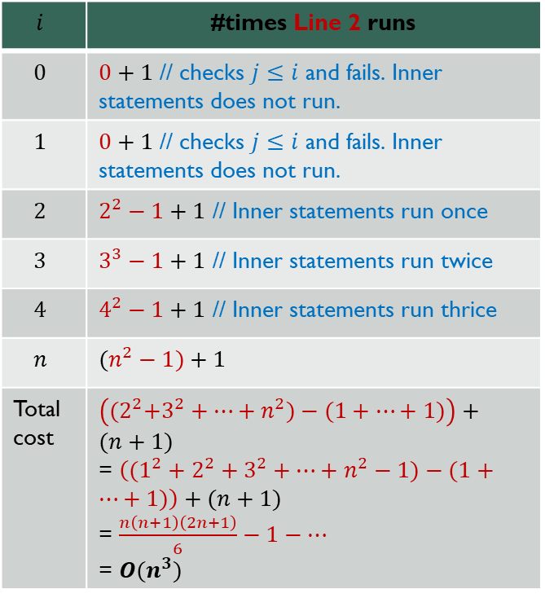
EXACT COST ANALYSIS: example 5
$$i$$ | #times Line 2 runs
$$0$$ | $0+1$ // checks $j≤i$ and fails. Inner statements does not run.
$$1$$ | $0+1$ // checks $j≤i$ and fails. Inner statements does not run.
$$2$$ | $2^{2}−1+1$ // Inner statements run once
$$3$$ | $3^{3}−1+1$ // Inner statements run twice
$$4$$ | $4^{2}−1+1$ // Inner statements run thrice
$$n$$ | $$(n^{2}−1)+1$$
Total cost | $\left({(2}^{2}+3^{2}+…+n^{2})−(1+…+1)\right)+(n+1)$ = $\left((1^{2}+2^{2}+3^{2}+…+n^{2}−1)−(1+…+1)\right)+(n+1)$ = $\frac{n\left(n+1\right)\left(2n+1\right)}{6}−1−…$ = $O(n^{3})$

Slide 32
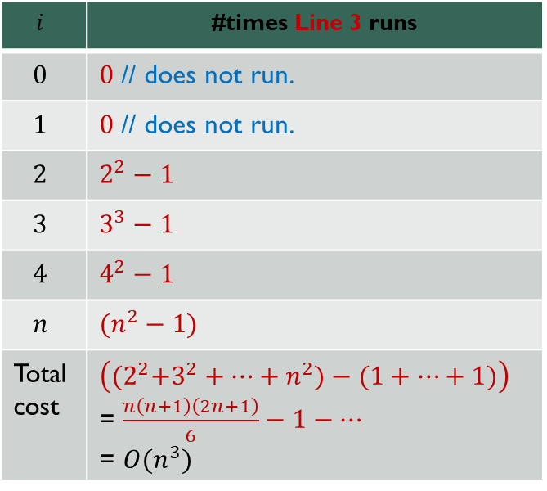
EXACT COST ANALYSIS: example 5
$$i$$ | #times Line 3 runs
$$0$$ | $0$ // does not run.
$$1$$ | $0$ // does not run.
$$2$$ | $$2^{2}−1$$
$$3$$ | $$3^{3}−1$$
$$4$$ | $$4^{2}−1$$
$$n$$ | $$(n^{2}−1)$$
Total cost | $\left({(2}^{2}+3^{2}+…+n^{2})−(1+…+1)\right)$ = $\frac{n\left(n+1\right)\left(2n+1\right)}{6}−1−…$ = $O(n^{3})$

Slide 33
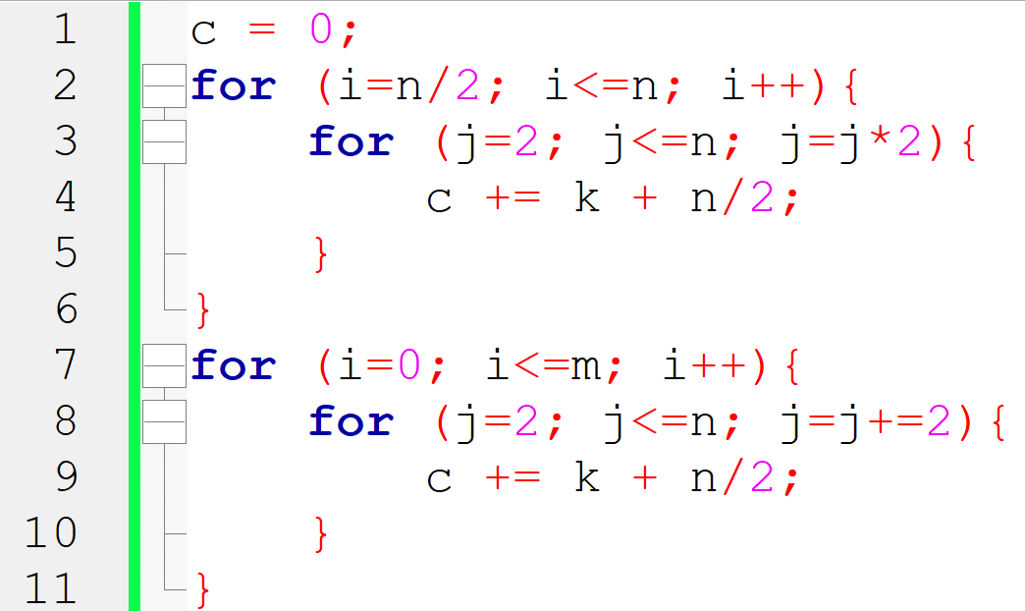
EXACT COST ANALYSIS: example 6
Line | Worst | Best
1
2
3
4
5
Asymptotic
Derive the running-time equations and express in "O" notation

Slide 34
Practice

Slide 35
Question patterns
Derive the best and worst case running-time equations and express in O notation.
Derive the exact cost equation and express in O notation
Provide best and worst case examples

Slide 36
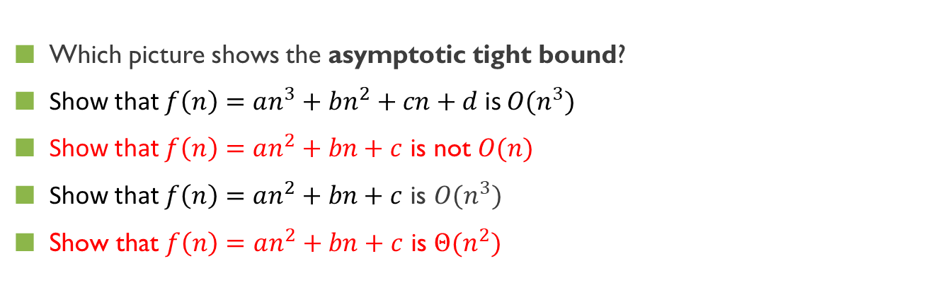
QUICK EVALUATION 1
Which picture shows the asymptotic tight bound?
Show that $f\left(n\right)=an^{3}+bn^{2}+cn+d$ is $O(n^{3})$
Show that $f\left(n\right)=an^{2}+bn+c$ is not $O(n)$
Show that $f\left(n\right)=an^{2}+bn+c$ is $O(n^{3})$
Show that $f\left(n\right)=an^{2}+bn+c$ is $Θ(n^{2})$

Slide 37
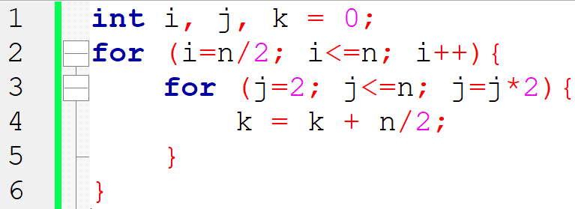
QUICK EVALUATION 2
What is the time complexity of the code?
Derive the exact cost equation and express in O notation
https://www.geeksforgeeks.org/practice-questions-time-complexity-analysis/
Notes:
If you notice, j keeps doubling till it is less than or equal to n. Number of times, we can double a number till it is less than n would be log(n). Let’s take the examples here. for n = 16, j = 2, 4, 8, 16 for n = 32, j = 2, 4, 8, 16, 32 So, j would run for O(log n) steps. i runs for n/2 steps. So, total steps = O(n/ 2 * log (n)) = O(n*logn)

Slide 38
QUICK EVALUATION 2
What is the time complexity of the code?
Derive the exact cost equation and express in O notation
https://www.geeksforgeeks.org/practice-questions-time-complexity-analysis/
Notes:
If you notice, j keeps doubling till it is less than or equal to n. Number of times, we can double a number till it is less than n would be log(n). Let’s take the examples here. for n = 16, j = 2, 4, 8, 16 for n = 32, j = 2, 4, 8, 16, 32 So, j would run for O(log n) steps. i runs for n/2 steps. So, total steps = O(n/ 2 * log (n)) = O(n*logn)

Slide 39
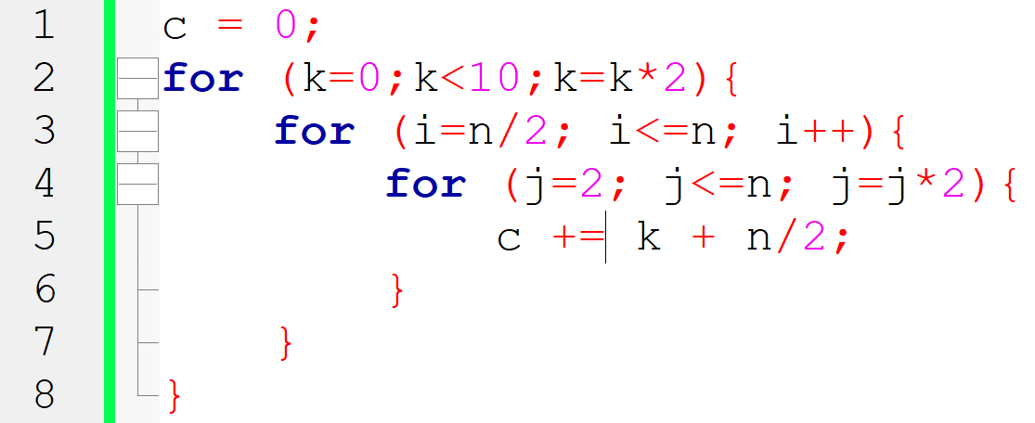
QUICK EVALUATION 3
What is the time complexity of the code?
Derive the exact cost equation and express in O notation
Notes:
If you notice, j keeps doubling till it is less than or equal to n. Number of times, we can double a number till it is less than n would be log(n). Let’s take the examples here. for n = 16, j = 2, 4, 8, 16 for n = 32, j = 2, 4, 8, 16, 32 So, j would run for O(log n) steps. i runs for n/2 steps. So, total steps = O(n/ 2 * log (n)) = O(n*logn)

Slide 40
QUICK EVALUATION 3
What is the time complexity of the code?
Derive the exact cost equation and express in O notation
Notes:
If you notice, j keeps doubling till it is less than or equal to n. Number of times, we can double a number till it is less than n would be log(n). Let’s take the examples here. for n = 16, j = 2, 4, 8, 16 for n = 32, j = 2, 4, 8, 16, 32 So, j would run for O(log n) steps. i runs for n/2 steps. So, total steps = O(n/ 2 * log (n)) = O(n*logn)

Slide 41
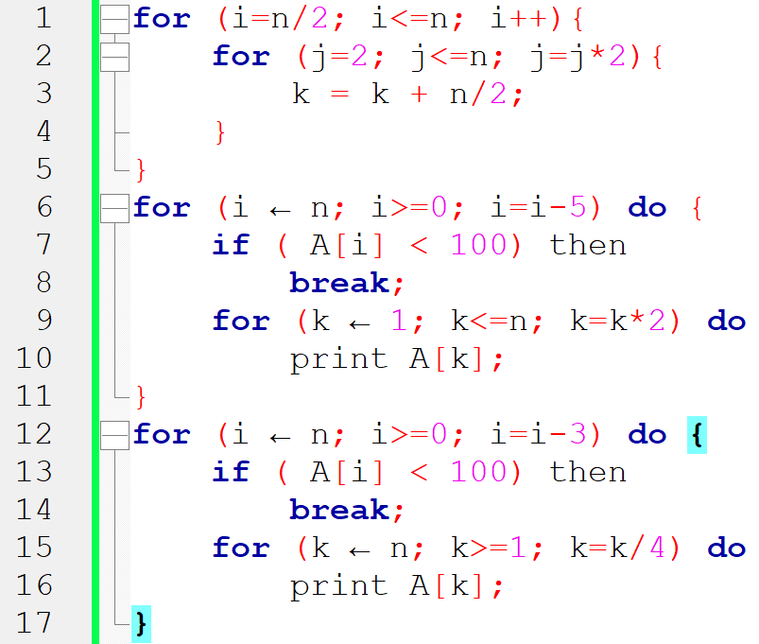
QUICK EVALUATION 4
What is the time complexity of the code?
Derive the exact cost equation and express in O notation
Notes:
If you notice, j keeps doubling till it is less than or equal to n. Number of times, we can double a number till it is less than n would be log(n). Let’s take the examples here. for n = 16, j = 2, 4, 8, 16 for n = 32, j = 2, 4, 8, 16, 32 So, j would run for O(log n) steps. i runs for n/2 steps. So, total steps = O(n/ 2 * log (n)) = O(n*logn)

Slide 42
Resources
https://www.cs.auckland.ac.nz/courses/compsci220s1t/lectures/lecturenotes/GG-lectures/BigOhexamples.pdf
http://www.cs.utsa.edu/~bylander/cs3233/big-oh.pdf
https://youtu.be/FEnwM-iDb2g
https://stackoverflow.com/questions/11227809/why-is-processing-a-sorted-array-faster-than-processing-an-unsorted-array/11227902#11227902

